Slide 1
Health Information Management: Concepts, Principles, and Practice
Fifth Edition
Chapter 28
Ethical Issues in Health Information Management

Slide 2
Learning Objectives
Examine ethics and ethical dilemmas
Interpret the concepts of morality, code of conduct, and moral judgment
Assess the AHIMA Code of Ethics
Differentiate how cultural issues affect health and healthcare quality, cost, and health information management
Evaluate the consequences of a breach of healthcare ethics
Determine the ethical issues related to research
Apply HIM ethical standards of practice
Evaluate the culture of a department and policies that support a culture of diversity

Slide 3
Introduction
HIM professionals are guided by a code of conduct and a professional code of Ethics
A set of principles regarding business practices and professional behavior
Ethics is the field of study addressing moral principles, theories, and values

Slide 4
Moral Values and Ethical Principles
Altruism
Autonomy
Beneficence
Consequentialism
Deontology
Egoism
Least Harm
Utilitarianism
Notes:
Moral values: A system of principles by which one guides one’s life, usually with regard to right or wrong
Ethical Principles: Helps with decision making

Slide 5
Cultural Competence and Diversity
Competence: The ability to accept and understand the beliefs and values of other people and groups
Diversity: The perceived or actual difference among people

Slide 6
Disparities in US Healthcare
Social determinants of health relate to the condition in which persons are born, grow, live work and age including difference in health status.
Health disparities exist disproportionately in certain populations

Slide 7
Cultural Competence Awareness
Challenge colleagues
Include diversity
Do not make assumptions
Honestly assess individuals and the HIM department as a whole

Slide 8
Training Programs
Create a cultural audit strategy to define an organization’s values, symbols, and routines to identify areas for improvement
  Availability of interpreter services
  Effectiveness of cultural training
  Are there differences in services among diverse populations
  What is the impact of culturally competent services

Slide 9
Regulations for Cultural Awareness
Federal law prohibits discrimination based on ethnicity, religion, disability and age
Equal Employment Opportunity Commission helps provide equal employment opportunities

Slide 10
Ethical Foundations of HIM
First ethical pledge was present in 1934 by Grace Whiting Myers
    “I pledge myself to give out no information from any clinical record placed in my charge, or from any other source to any person whatsoever, except upon order from the chief executive officer of the institution which I may be serving” (Huffman 1972).

Slide 11
Protection of Privacy
Freedom from unauthorized intrusion in healthcare, includes the right of a patient to control the disclosure of protected health information

Slide 12
Maintenance of Confidentiality
Confidentiality is a legal and ethical concept that requires healthcare providers to protect health records and other personal and private information from unauthorized use or disclosure

Slide 13
AHIMA Code of Ethics
“The ethical obligations of the HIM professional include the safeguarding of privacy and security of health information; disclosure of health information; development, use and maintenance of health information systems and health information; and ensuring the accessibility and integrity of health information”
(AHIMA 2011 Preamble to Code of Ethics)

Slide 14
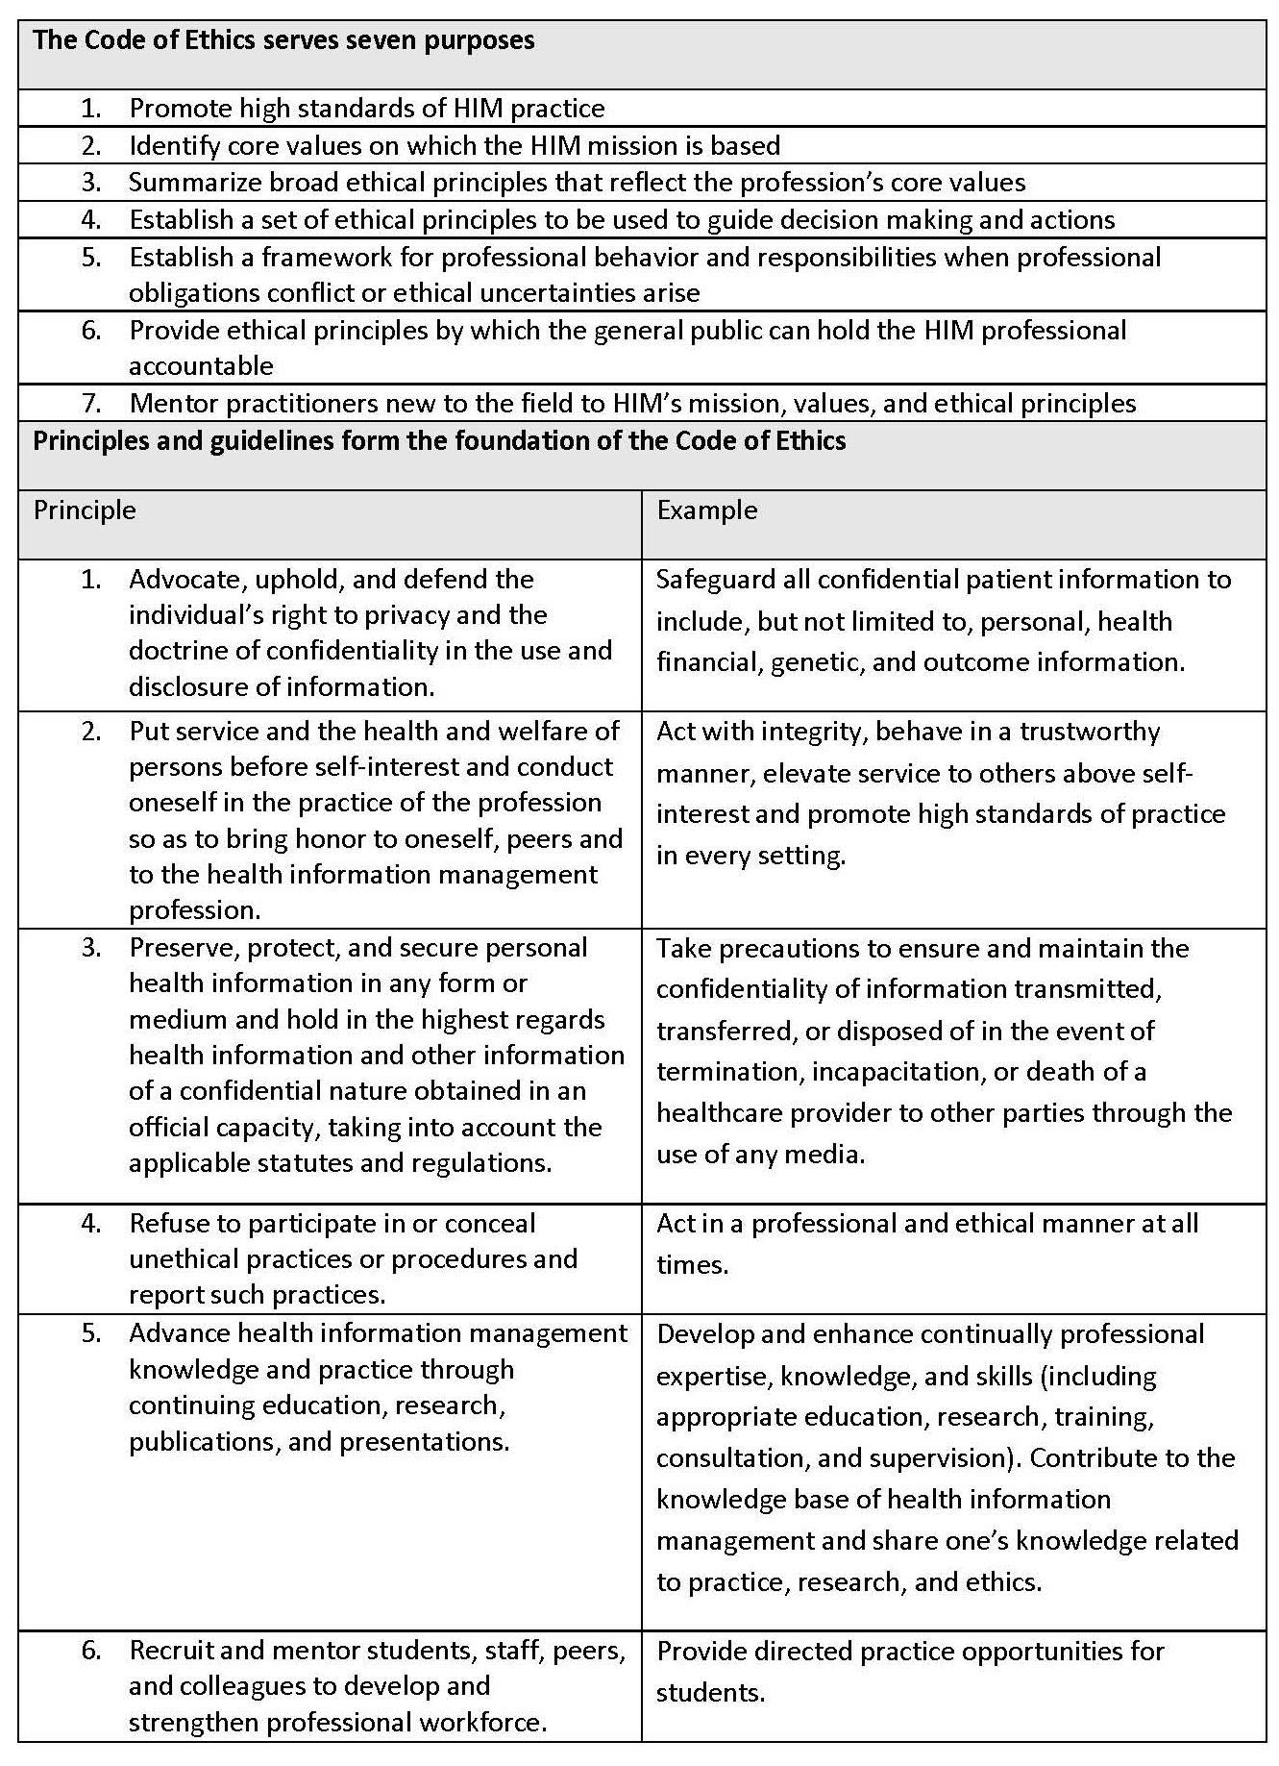
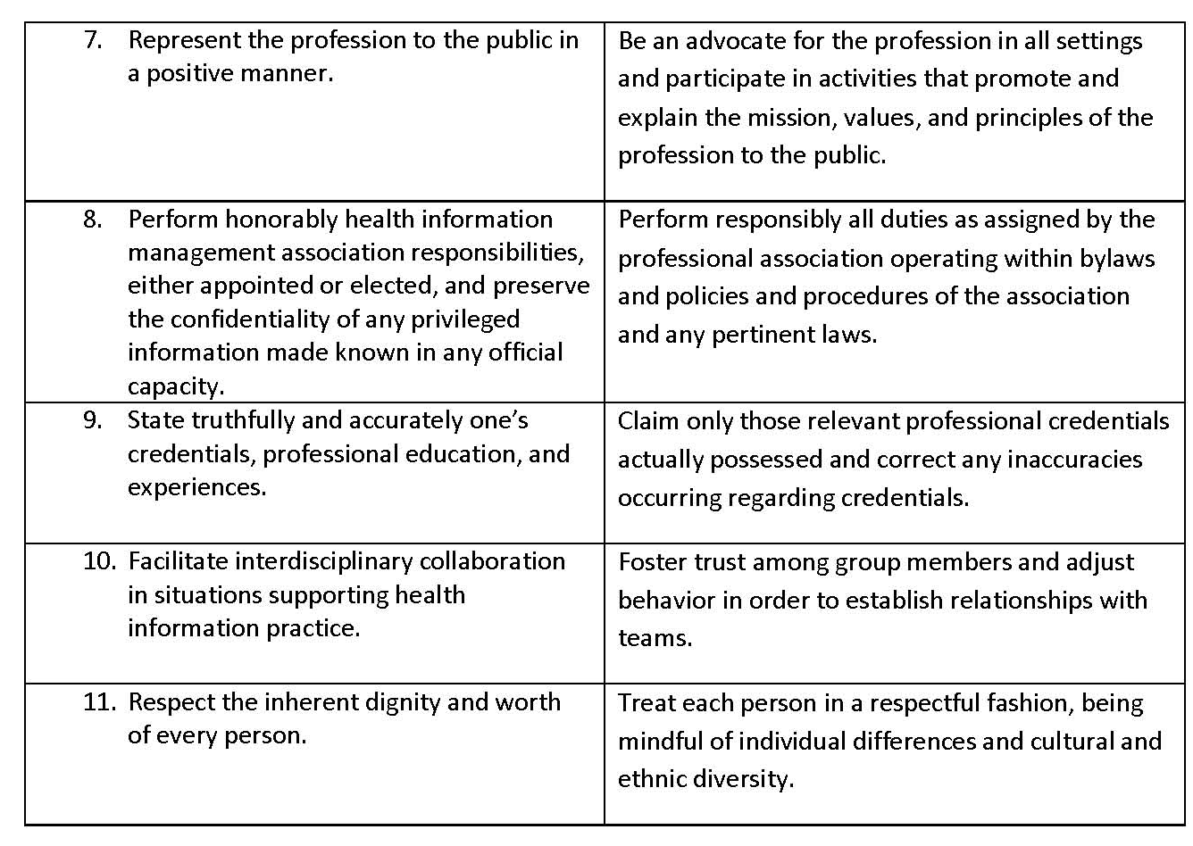

Slide 15
Professional Values and Obligations
Quality
Integrity
Respect
Leadership

Slide 16
Medical Identity Theft
The fraudulent use of an individual’s identifying information in a healthcare setting

Slide 17
Ethical Decision Making
What is the ethical question?
What are the facts?
What are the options?
What is the decision (what HIM values are at stake)?
What justifies the choice?
Who are the stakeholders?
What is the prevention (so the issue is not repeated)?

Slide 18
Example of Process
Dilemma: Using the RHIA credential without passing the exam
Facts: Does not have RHIA and is using the credential. Co-worker knows
Decision Employee giving warning, told to stop using the RHIA, AHIMA notified
Options: (1) Do nothing (2) Report to AHIMA (3) Terminate employee (4) Repremand employee
Prevention: Employees taking exams must bring results to the supervisor
Stakeholders:- Kristi, the department, AHIMA
Justification: The AHIMA Code of Ethics outlines that is is unethical to use the RHIA without earning it.

Slide 19
Breach of Healthcare Ethics
Medical Ethics Committee
HIM Ethics responsibilities

Slide 20
HIM Ethical Problems
Documentation and Privacy
Release of Information
Coding
Quality Management
Decision Support
Public Health
Managed Care
Sensitive Health Information
Research
EHR

