Slide 1
Health Information Management: Concepts, Principles, and Practice
Fifth Edition
Chapter 27
Project Management

Slide 2
Purpose of a Project
Current
State
Project
New
State
Change

Slide 3
Project Characteristics
Temporary and one-time instance of work
Use of resources from multiple disciplines
Defined and specific outcome goals
Limited resource budgets
Targeted start and end dates

Slide 4
Operations vs. Project

Slide 5
Project Sources

Slide 6
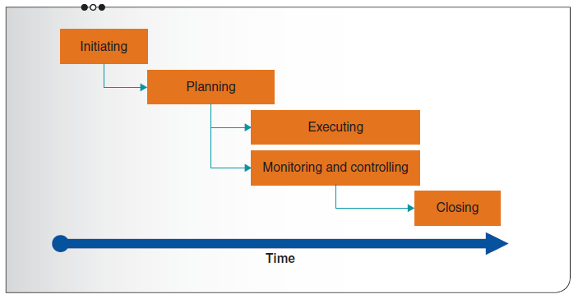
Project Management Process Groups

Slide 7
Project Constraints

Slide 8
Project Members
Sponsor—owns or funds project
User/recipient—directly affected by deliverables
Project manager—coordinates and manages effort
Champion—executive advocating for the project
Team—specialists executing project tasks

Slide 9
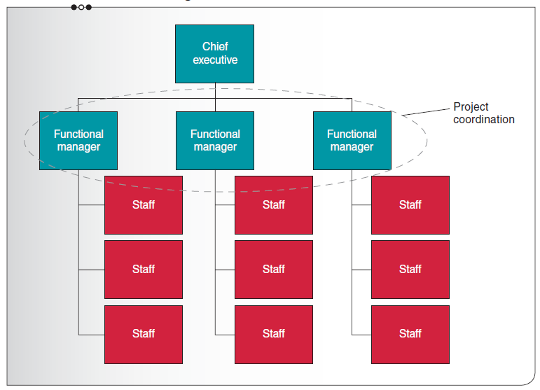
Functional Organization

Slide 10
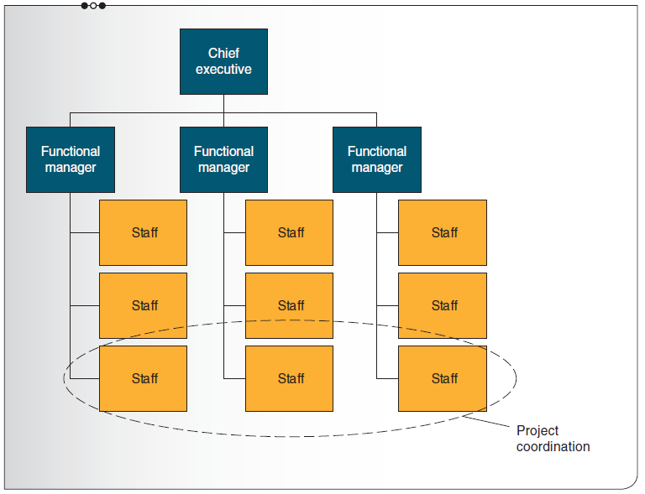
Weak Matrix Organization

Slide 11
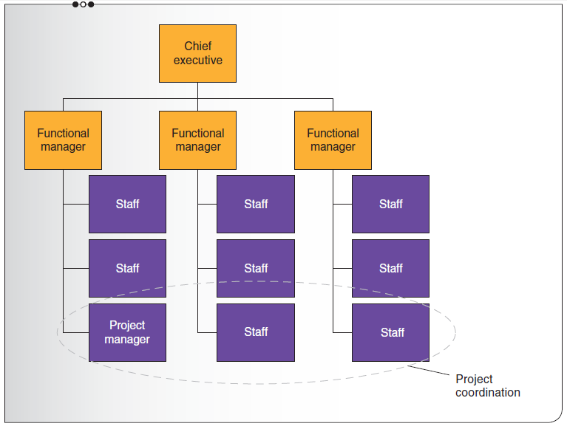
Balanced Matrix Organization

Slide 12
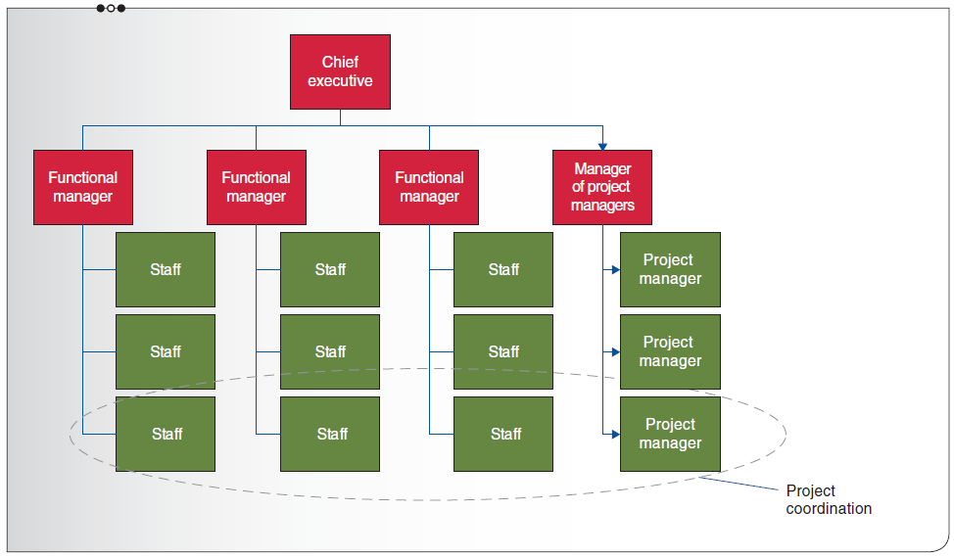
Strong Matrix Organization

Slide 13
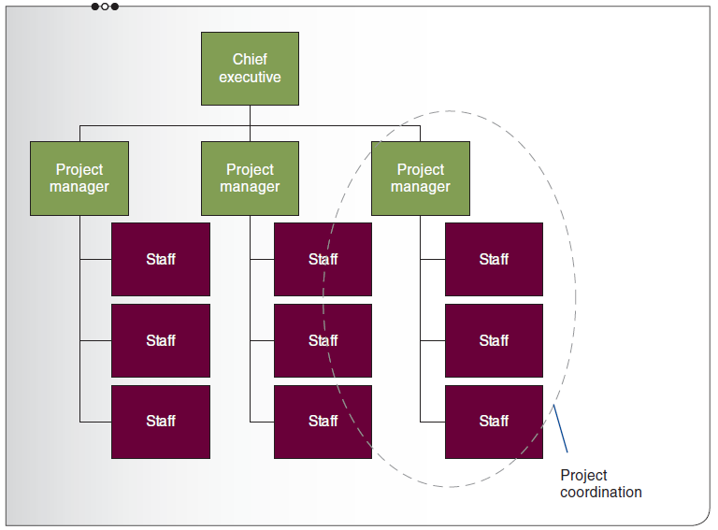
Projectized Organization

Slide 14
Change and Organization Structure
 | Functional | Weak Matrix | Balanced Matrix | Strong Matrix | Projectized
Change Frequency | Stable | Low | Moderate | High | Continual
Project Manager’s Authority | Little or None | Low | Low to Moderate | Moderate to High | High
Project Manager’s Role | Part-time | Part-time | Part-time | Full-time | Full-time
Source: Adapted from: PMI (2013a)

Slide 15
Project Manager Roles
Manage resources
Manage scope
Manage quality
Manage schedule
Manage costs
Manage communications

Slide 16
Project Manager Competencies

Slide 17
Project Management Process Groups

Slide 18
Process Group—Initiating

Slide 19
Process Group—Planning

Slide 20
Process Group—Executing

Slide 21
Process Group—Monitoring and Controlling

Slide 22
Process Group—Closing

Slide 23
Requirements Matrix
ID | Description | Priority
1 | Hold event on a weekday evening to maximize the number of attendees | A
2 | Meeting room should hold at least 150 people | B
3 | Meeting location should be within 10 miles from office | B
4 | The meeting location must allow external catering | A
5 | The speaker must have experience related to the educational topic | A
6 | It would be nice if the speaker has never presented at a previous event | C
7 | The food should be healthy | B
8 | The food must be served in individual portions | A

Slide 24
Work Breakdown Structure (WBS)
Project
Phase 1
Phase 2
Phase 3
Activity 1
Task 1
Task 2
Activity 2
Activity 1
Task 1

Slide 25
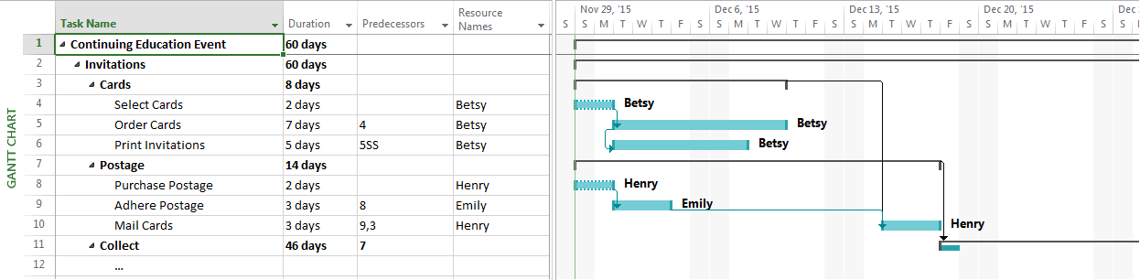
Gantt Chart

Slide 26
Types of Change

Slide 27
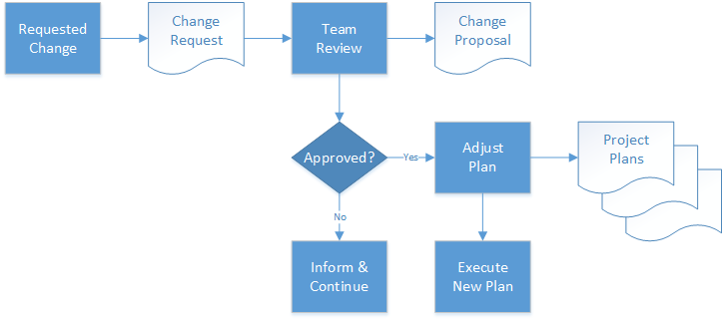
Change Management Process

