Slide 1
Health Information Management: Concepts, Principles, and Practice
Fifth Edition
Chapter 26
Financial Management

Slide 2
HIM and Financial Management
Board of Directors
Chief Executive Officer
(CEO)
Chief Financial
Officer
(CFO)
Chief Operating Officer
(COO)
Chief Information Officer
(CIO)
Chief Nursing
Officer
(CNO)
Patient Accounts
Accounting
Decision Support
Investment Management
Managed Care Contracting
Purchasing
Ancillary Departments (Radiology, Lab, Pharmacy)
Case Management
Food Service
Facilities
Housekeeping
Human Resources
Marketing
HIM
Clinical Information Systems
Enterprise Technology Services
IT Infrastructure
Telecommunications
Nursing

Slide 3
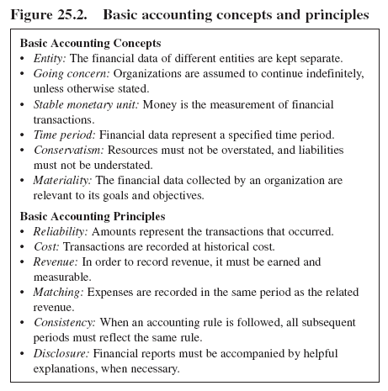
Accounting Concepts and Principles

Slide 4
Authorities
Financial Accounting Standards Board (FASB)
Securities and Exchange Commission (SEC)
Internal Revenue Service (IRS)
Public Company Accounting Oversight Board (PCAOB)
Centers for Medicare and Medicaid Services (CMS)

Slide 5
Forms of Business Organization
Sole proprietor
Partnership
Corporation

Slide 6
Financial Organization
For-Profit Organizations
Not-for-Profit Organizations
  501(c)(3)
  501(c)(6)
Tax Status Issues
Notes:
In some states (e.g. New Jersey), charitable organizations must register with a regulatory body in addition to obtaining NFP status. States require this in order to protect consumers and to monitor solicitation practices. Students can research requirements in their home state and go to the IRS web site to review IRS Pub 557, which contains detailed information about the types of organizations that can be tax exempt.

Slide 7
Sources of Financial Data
Transactions
Clinical Services
Patient Accounts
Health Information Management
Administration

Slide 8
Uses of Financial Data
Reimbursement
Controlling
Planning
Forecasting

Slide 9
Basic Financial Accounting
Measuring transactions
Recording transactions
Communication
Notes:
Financial accounting is all about communication. Financial data is used to communicate with external stakeholders as well as to build internal communication tools such as budget and productivity reports.

Slide 10
Assets
Cash
Inventory
Accounts receivable
Building
Equipment
  Purchase price
  Depreciation

Slide 11
Liabilities Net Assets/Equity
Accounts payable
Loans payable
Mortgage
Synonymous terms
Represent the “book value” of the organization
Notes:
Accounts payable result from routine transactions.
Notes payable are sort of an extended payment plan for businesses.
Mortgages are long-term and have underlying collateral, such as a building.

Slide 12
The Accounting Equation
Assets – Liabilities =
Net Assets(Equity)

Slide 13
Revenue Expenses
Sources of revenue
Categories of revenue
  Operating revenue
  Non-operating revenue
Purchasing
Organization
Purchase orders
Shipping/receiving documents
Invoices
Statements
Inventory slips

Slide 14
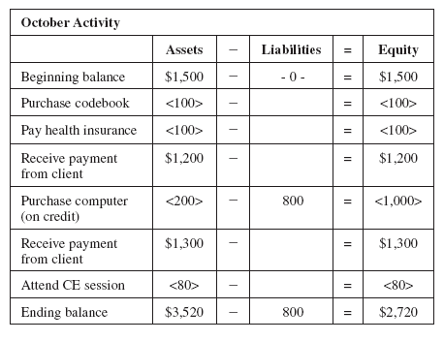
Illustrating the Equation
Notes:
Students who have not taken a separate course in accounting may relate better to this example if they see:
Assets as a combination of their checkbook balance and things they purchased
Liabilities as their credit card balance (car loan, mortgage)
Equity as the net value of the two

Slide 15
Recording Transactions
Double-entry bookkeeping
Debits and credits
Impact on individual accounts

Slide 16
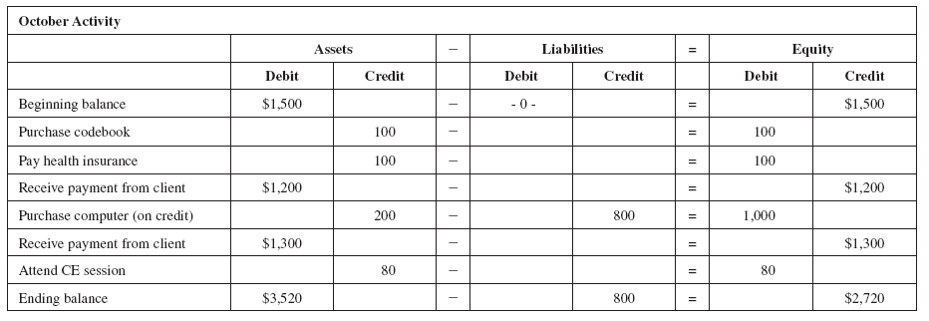
Double-entry Bookkeeping

Slide 17
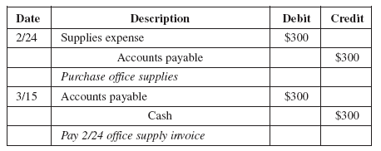
Keeping Track of Transactions: Journal Entry
General Ledger

Slide 18
Financial Statements
Income statement
Retained earnings
Balance sheet

Slide 19
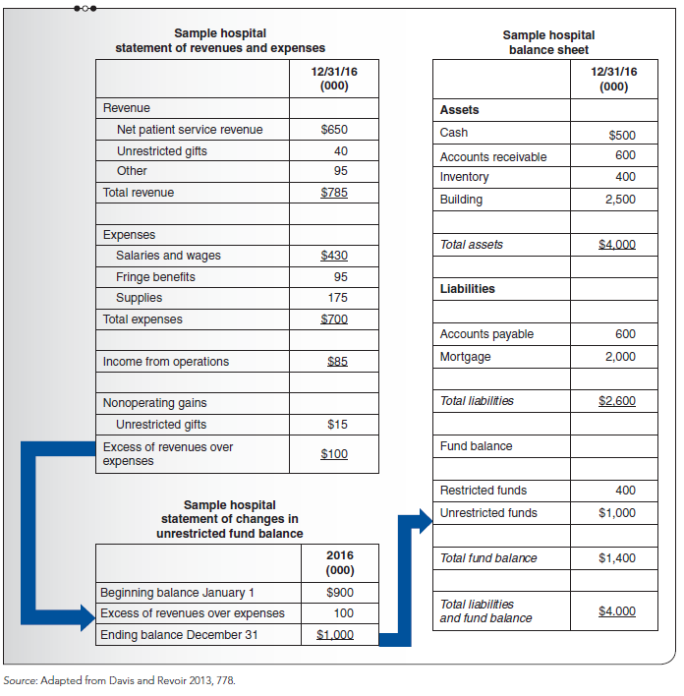
Income Statement

Slide 20
Ratio Analysis
Liquidity and debt service
  Current ratio
  Days in accounts receivable
  Debt ratio
Profitability
  Return on investment
  Total margin

Slide 21


Liquidity Ratios
Current Ratio
Days in Accts Receivable

Slide 22
Debt Ratio
Total liabilities
Total assets

Slide 23
Profitability Ratios
Return on Investment
Earnings
Total assets
Total Margin
Excess of Revenue over Expense
Total Revenue

Slide 24
Basic Managerial Accounting
Identifying costs
Management control
Communication

Slide 25
Describing Costs
Direct costs
Indirect costs
Fixed costs
Variable costs
Semi-fixed costs

Slide 26
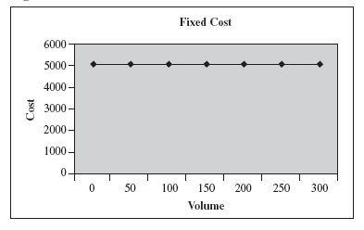
Fixed Costs
Notes:
Copy machine depreciation costs do not vary, regardless of copy volume.

Slide 27
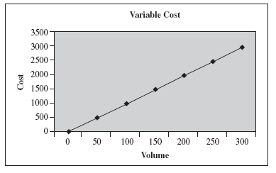
Variable Costs
Notes:
Cost of copy paper tied directly to volume of requests.

Slide 28
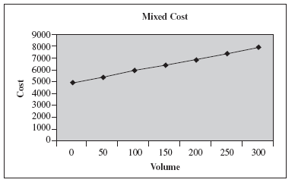
Semi-Fixed Costs
Notes:
Coding coverage example. In-house coding staff salaries are fixed. Per chart consulting fees are tied to volume and increase the cost of coding variably.
This chart also shows the total copy costs: fixed depreciation plus cost of paper.

Slide 29
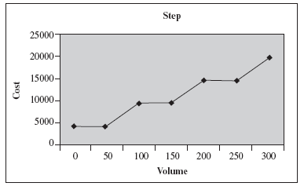
Semi-Fixed Costs
Notes:
Nursing salaries example. Nursing staffing increases incrementally according to the ratio of nurses to inpatients.
In terms of copy costs, ROI personnel costs may vary incrementally. In other words, at certain volume levels, additional personnel must be assigned to the task in order to meet demand.

Slide 30
Cost Reports
Allocation of overhead
  Direct method
  Step-down allocation
  Double distribution
  Simultaneous equations
Impact of accounts receivable on financial statements

Slide 31
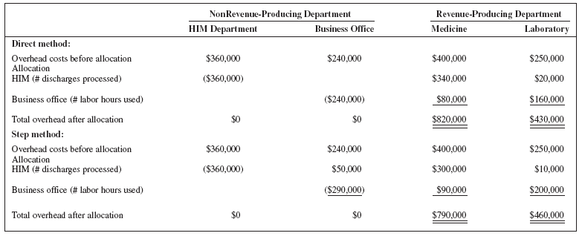
Allocation

Slide 32
Internal Controls
Preventive
Detective
Corrective

Slide 33
Budgets
Types of budgets
  Fixed
  Flexible
  Activity-based
  Zero-based

Slide 34
Operational Budgets
Budget cycle
  Fiscal period
  Interim periods
Budget components
  Revenues
  Expenses

Slide 35
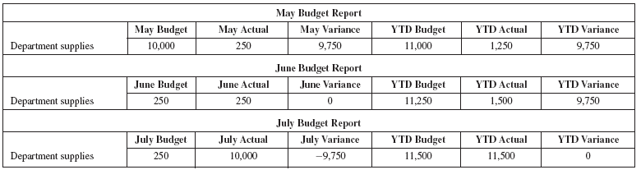
Management of the Operating Budget

Slide 36
Identification of Variances Explanation of Variances
Timing
Permanent
Temporary
Impact
Favorable
Unfavorable
Amount
Cause
Circumstances

Slide 37
Explanation of Variances
Amount
Cause
Circumstances

Slide 38
Capital Budget
Large-dollar purchases
Acquisitions
Cost-benefit analysis
Depreciation

Slide 39
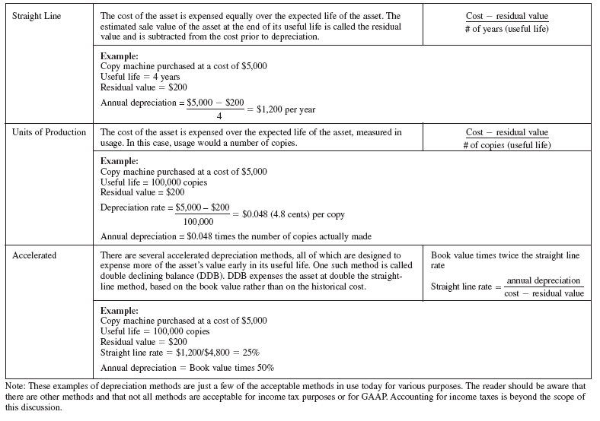
Depreciation

Slide 40
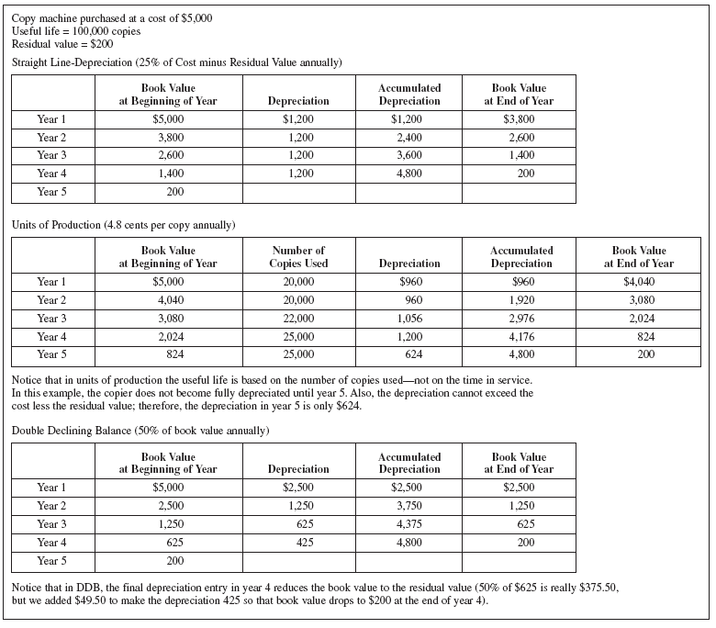

Slide 41
Capital Projects Cost Justification
Replacement
Expansion
Mission
Profitability
Payback period
Accounting rate of return
Return on investment
Net present value
Internal rate of return
Profitability index

Slide 42
Payback Period
Investment: $100,000
Cash In: $50,000 per year
Payback Period: 2 years (100,000 / 50,000)
Notes:
The payback period is the time required to recoup the cost of an investment. Mortgage refinancing analysis frequently uses the concept of payback period. Mortgage refinancing is considered when interest rates have dropped. Refinancing may require up-front interest payments, called points, as well as a variety of administrative costs. In this example, the payback period is the time it takes for the savings in interest to equal the cost of the refinancing.
The advantage of using a payback period to analyze investments is that it is relatively easy to calculate and understand. For example, a payback period can be used to describe the time it takes for the savings in payroll costs to equal the cost of productivity-enhancing equipment. In the previous photocopy machine example, the payroll costs would be calculated based on downtime incurred when using a copier in another area of the building.
The disadvantage of a payback period is that it ignores the time value of money. Because the funds used for one capital investment could have been invested elsewhere, there is always an inherent opportunity cost of choosing one investment over another. Hence, there is an assumed rate of return against which investments are compared and a benchmark rate of return under which a facility will not consider an investment.

Slide 43
Accounting Rate of Return
Investment: $100,000
Straight Line Depreciation over 5 years: $20,000 per year
Cash In: $50,000 per year
ARR: 30% [(50,000 – 20,000) / 100,000]
Notes:
Another simple method of capital project analysis is the accounting rate of return. This method compares the projected annual cash inflows, minus any applicable annual depreciation, divided by the initial investment. Consider the purchase of a CT scanner. Reimbursement from use of the machine is the cash inflow. Depreciation is easily calculated, based on the initial investment.
Accounting rate of return is another example of a simple method of capital project analysis. However, it also ignores the time value of money. In addition, accounting rate of return is based on an estimate. If the analyst incorrectly projects annual cash inflows, the projected rate of return will be incorrect.

Slide 44
Return on Investment
Investment: $100,000
Straight Line Depreciation over 5 years: $20,000 per year
Operating Costs: $5,000 per year
Cash In: $50,000 per year
ROI: 25% [(50,000 – 25,000) / 100,000]
Notes:
Return on Investment (ROI) is most frequently used to analyze marketable securities retrospectively. The increase in market value of the securities divided by the initial investment is the ROI. When an income stream is associated with the investment, the income stream is added to the market value of the securities in calculating return. In comparing the ROI among different securities, the tax implications must be considered. Long-term gains are taxed differently than short-term gains. Tax-exempt investments result in different returns than taxable investments.
With respect to capital investments, the equation is similar. Divide the controllable operating profits by the controllable net investment. Operating profits are the cash inflow minus the direct costs of operation.
As with accounting rate of return and payback period, ROI is easy to calculate and understand. Similarly, it does not consider the time value of money.

Slide 45
Net Present Value
Investment: $100,000
Cash In: $25,000 per year (revenue minus depreciation and operating costs)
Interest Rate: 7%
NPV: $2,505 (based on 5 years of service)
Notes:
To take into consideration the time value of money, the analyst must establish an interest rate at which money could have otherwise been invested. From that implied interest rate and the projected future cash inflows of the investment, the present value of the cash inflows is calculated. Present value is the current dollar amount that must be invested today in order to yield the projected future cash inflows at the implied interest rate. Net present value is the calculated present value of the future cash inflows compared to the initial investment.
The advantage of using net present value to analyze investments is that it considers the time value of money. When choosing among like investments, net present values can be reliably compared to determine the financial advantages of the investment.
As with other analysis tools, analysts may have to estimate the projected cash flows. However, the main disadvantage of net present value is that the interest rate is subjective. Therefore, it is best used to compare multiple investment opportunities rather than to analyze one investment alone. Another disadvantage of using net present value is that it requires some knowledge of mathematics to calculate as well as to accept its validity and understand its relevance. Fortunately, financial calculators and computer spreadsheet programs have made the calculation of net present value relatively simple.

Slide 46
Internal Rate of Return
Investment: $100,000
Cash In: $25,000 per year (revenue minus depreciation and operating costs)
NPV: $0 (based on 5 years of service)
Interest Rate: 8%
Notes:
Internal rate of return (IRR) is the interest rate that makes the net present value calculation equal zero. In other words, it is the interest rate at which the present value of the projected cash inflows equals the initial investment. IRR considers the time value of money. Both individual and multiple investments can be evaluated. As with net present value, a knowledge of mathematics is helpful. The main disadvantage is that a project may have multiple IRRs.

Slide 47
Profitability Index
Radiology Pharmacy
$1,500,000 Present value of cash inflows $40,000
$500,000 Present value of cash outflows $10,000
3 Profitability index 4
Notes:
Facilities cannot automatically invest in seemingly profitable projects. For example, a $500,000 radiology equipment investment may have a present value of cash inflows of $1,500,000, for a net present value of $1,000,000. At the same time, a $10,000 pharmacy computer system yields a net present value of $30,000. This seems to be a great investment; however, the facility’s capital budget may be limited to $100,000. In this case, a profitability index helps the organization prioritize investment opportunities. For each investment, divide the present value of the cash inflows by the present value of the cash outflows. In this example, the pharmacy system has a higher profitability index

