Slide 1
Health Information Management: Concepts, Principles, and Practice
Fifth Edition
Chapter 22
Managing and Leading During Organization Change

Slide 2
Landmarks in Management as a Discipline
  Scientific management
    Max Weber—Bureaucracy
    Frederick Taylor—Production efficiency
    Frank and Lillian Gilbreth—Time and motion studies
    Henry Gantt—Task scheduling
  Administrative management
    Henry Fayol—4 functions and 16 principles of management
    Chester Barnard—Communication channels
    Mary Parker Follett—Empowered employees; work groups

Slide 3
Landmarks in Management as a Discipline (continued)
  Humanistic management
    Hawthorne studies
    Human resources management
    Douglas McGregor—X and Y theory of management
  Operations management
    Forecasting
    Linear programming
    Break-even analysis, and such
  Contemporary management
    Peter Drucker (management by objectives)
    W. Edwards Deming (total quality management)
    Business process reengineering

Slide 4
Management Functions
Planning—Determining what should be accomplished
  Mission and values statement
  Strategic plan
  Tactical plans
  Operational plans
Organizing—Deciding how resources can be allocated
  Organization chart
  Line authority and staff authority
  Span of control
  Delegation

Slide 5
Management Functions (continued)
Directing/leading—Influencing behavior; motivating and inspiring other to high performance
  Sources of Influence (Power)
    Authority
    Reward
    Coercive
    Referral
    Expert
    Information
Controlling/evaluating—Monitoring performance and making course corrections
  Dashboards and the balanced score card

Slide 6
Levels of Management and Skills
Supervisory management (frontline management) —Significant use of technical skills
Middle management—Significant use of interpersonal skills, including emotional intelligence (EI)
Top Management—Significant use of conceptual skills
  Executive management
  Governing boards

Slide 7
Managerial Activities and Associated Roles
Interpersonal activities
  Figurehead—Liaison—Leader
Informational activities
  Monitor—Disseminator—Spokesperson
Decisional activities
  Entrepreneur
  Disturbance handler
  Resource allocator
  Negotiator

Slide 8
Trends in Management Theory
Problem solving and decision making
  Steps in decision making
  Rational versus administrative decision making
  Programmed and nonprogrammed decisions
Groupthink
  Symptoms of groupthink
  Consequences of groupthink
  Countermeasures for groupthink

Slide 9
Managerial Communication
Formal and informal channels
Barriers to communication
Practices to increase accuracy of communications
Guidelines for giving feedback

Slide 10
Trends in Leadership Theory
Classical leadership theories
  Great person theory
  Trait approach
  Autocratic versus democratic leadership
Behavioral theories of leadership
  Narrative decision tree
  Ohio and Michigan studies
  Leadership grid
Contingency and situational theories of leadership
  Fiedler’s contingency model
  Hersey and Blanchard’s situational model
  Path-Goal theory
  Dyadic relationship theory
  Values-based leadership theory—Servant leadership model

Slide 11
Diffusion of Innovations
Categories of adopter groups
  Innovators—Risk takers
    Inventor
    Champion
    Sponsor
    Critic
  Early adopters—Local opinion leaders
  Early majority—Nonleaders “linkers”
  Late majority—Respond to economic and social pressure
  Laggards—Suspicious of change
Decision curve

Slide 12
Change Management
Change agents
  Internal change agents
  External change agents
Stages of change
  Lewin’s stages of change—Unfreezing, change, and refreezing
  Stages of grieving—Shock/denial, anger, bargaining, depression, and acceptance

Slide 13
Change Management (continued)
Resistance to change
Facilitation of change
  Bridges’s stages of transition—Ending, neutral zone, and new beginnings
  Reflective learning cycle—Doing, reflection, interpretation, and application

Slide 14
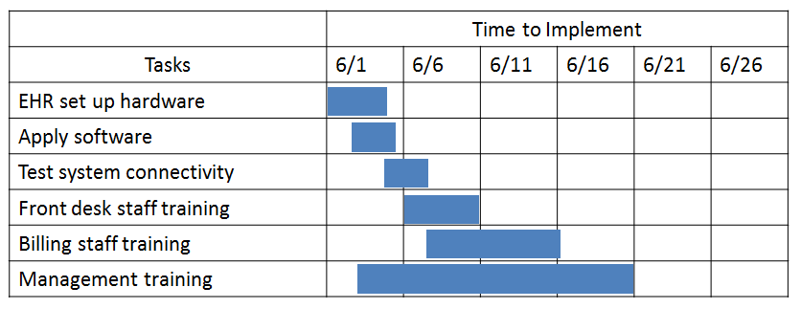
Gantt chart showing sequence of initial EHR implementation timeline.

Slide 15
Fayol’s Fourteen Principles
Specialization of labor: Work allocation and specialization allow concentrated activities, deeper understanding, and better efficiency. Authority: The person to whom responsibilities are given has the right to give direction and expect obedience. Discipline: The smooth operation of a business requires standards, rules, and values for consistency of action. Unity of command: Every employee receives direction and instructions from only one boss. Unity of direction: All workers are aligned in their efforts toward a single outcome. Subordination of individual interests: Accomplishing shared values and organizational goals take priority over individual agendas. Remuneration: Employees should receive fair pay for work.
[

Slide 16
Fayol’s Fourteen Principles
Centralization: Decisions are made at the top.
Scalar chain: Everyone is clearly included in the chain of command and line of authority from top to bottom of the organization.
Order: People should clearly understand where they fit in the organization, and all people and material have a place.
Equity: People are treated fairly, and a sense of justice should pervade the organization.
Tenure: Turnover is undesirable, and loyalty to the organization is sought.
Initiative: Personal initiative should be encouraged.
Esprit de corps: Harmony, cohesion, teamwork, and good interpersonal relationships should be encouraged.

Slide 17
Deming’s Fourteen Principles
Create a constancy of purpose toward continual improvement of products and services, with the objectives to stay in business, be competitive, and provide jobs. Adopt the new philosophy for a new economic age by correcting superstitious learning, calling for a major change, and looking at the customer rather than competition. Cease dependence on inspection to achieve quality by eliminating emphasis on mass inspection and building quality in from the beginning. Don’t award business based on price tag alone, and minimize total costs by developing trusting and loyal long-term relationships with single suppliers. Constantly and continually improve production and service systems and thereby improve quality and decrease costs.

Slide 18
Deming’s Fourteen Principles
Institute training on the job, where barriers to good work are removed and managers provide a setting that promotes worker success.
Institute leadership with the aim of revising supervision to better help people, machines, and processes do a better job.
Drive out fear so everyone can work effectively toward company goals.
Break down barriers between departments so that various departments can work as a team and anticipate problems of production or use of a product or service.
Avoid asking for new levels of productivity and zero defects through slogans and targets because most problems of low productivity lie with the system rather than the worker.

Slide 19
Deming’s Fourteen Principles
Replace work standards such as quotas, numerical goals, and MBO with good leadership.
Remove barriers that rob people at all levels of their pride of workmanship; shift from numbers to quality.
Institute a program of education and self-improvement by emphasizing lifelong learning and employment.
Transformation of the workplace occurs through everyone’s action.

Slide 20
Characteristics of Highly Successful Firms
A bias for action: They establish a value for action and implementation rather than overanalyzing and delaying with endless committees. Close to the customer: They listen and respond to customers to satisfy their needs. Autonomy and entrepreneurship: They empower people and encourage innovation and risk taking. Productivity through people: They increase employees’ awareness that everyone’s contributions lead to shared success. Hands on, value driven: Their managers should be visible, involved, and know what is going on.

Slide 21
Characteristics of Highly Successful Firms
Stick to the knitting: They stay with the core business, what they do well, and avoid wide diversification.
Simple form, lean staff: They have fewer administrative layers and keep the structure simple.
Simultaneous loose–tight properties: They maintain dedication to core principles but encourage flexibility and experimentation in reaching goals.

Slide 22
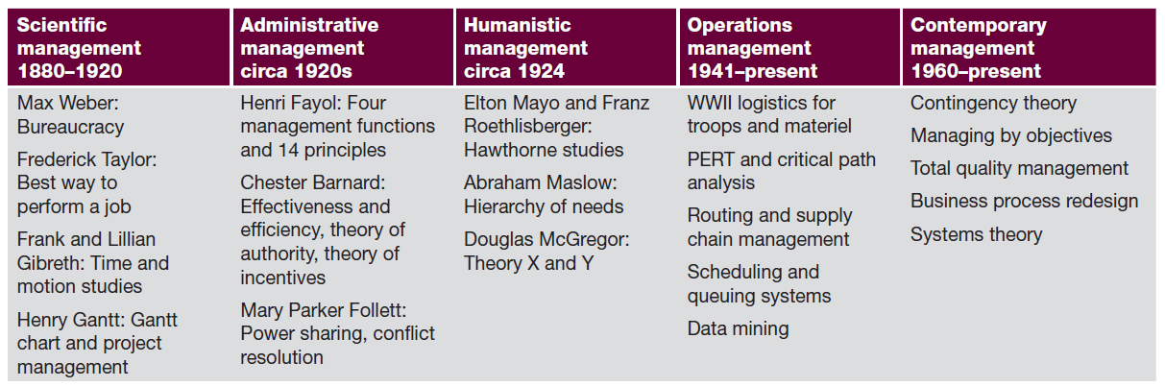
Foundations of Management Timeline

Slide 23
Sample Hospital Organizational Chart

Slide 24
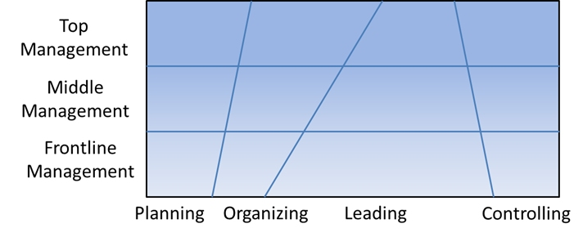
Management Functions by Organization Level

Slide 25
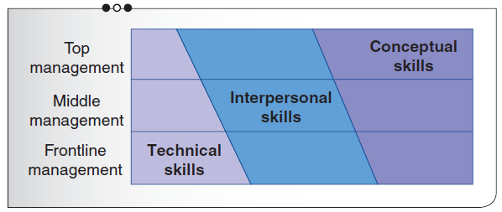
Functional Skills by Level in the Organization

Slide 26
Attributes of Emotional Intelligence
Self-awareness: The ability to monitor, notice, and label one’s feelings as they occur. This allows one to be more certain about feelings and to identify early vague feelings. Self-regulation: The ability to manage one’s emotions and impulses. A person with this skill is often viewed as being reflective, comfortable with change and ambiguity, and able to control impulsiveness. Motivation: Being highly motivated is essential for focusing attention, mastering situations, showing creativity, and being productive and successful.

Slide 27
Attributes of Emotional Intelligence
Empathy: The ability to recognize emotions in others. This is important for teamwork as well as for helping adjust one’s behavior to the emerging reactions of others.
Social skills: The ability to handle relationships with others is central to being perceived as popular, effective with others, and having the qualities of a leader.

Slide 28
Mintzberg’s Managerial Roles
Managerial Activity | Related Roles
Interpersonal | Figurehead: The manager represents the organization and is a symbol for ceremonial, social, legal, and inspirational duties. Liaison: The manager maintains networks of relationships outside his or her organizational unit to gather information and favors. Leader: The manager directs, guides, motivates, and develops subordinates.
Informational | Monitor: The manager oversees internal and external information sources. Disseminator: The manager communicates facts and values to others in the organization. Spokesperson: The manager communicates with others outside the organization.

Slide 29
Mintzberg’s Managerial Roles
Decisional | Entrepreneur: The manager promotes development and planned change in the organization. Disturbance handler: The manager resolves crises and unexpected problems. Resource allocator: The manager uses authority to allocate budget, personnel, equipment, services, and facilities. Negotiator: The manager resolves dilemmas and disputes and determines the use of resources.

Slide 30
Paradigm Shift in Management
Traditional Management Paradigm | New Management Paradigm
Multilevel hierarchical organization | Flatter, distributed organization
Centralized decision making | Decentralized decision making
Status measured by amount of turf controlled | Status measured by success in achieving outcomes
Funding inputs and intentions | Funding outcomes
Face-to-face interaction | Telecommunication and virtual interaction
Homogenous staffing | Workforce diversity

Slide 31
Paradigm Shift in Management
Job description | Skill portfolio
Annual strategic plan | Learning organization
Financial bottom line | Triple bottom line
Efficiency and stability | Ongoing innovation
Mass services | Market segmentation
Work at central office | Work at satellite and home offices

Slide 32
Symptoms of Groupthink
Team’s overestimation of its own power and morality Illusion of invulnerability Unquestioned belief in team’s inherent morality Close-mindedness Team rationalization to discount warnings Stereotypes of the opposition Pressure toward uniformity Self-censorship Illusion of shared unanimity Pressure to conform Self-appointed “mind guards”

Slide 33
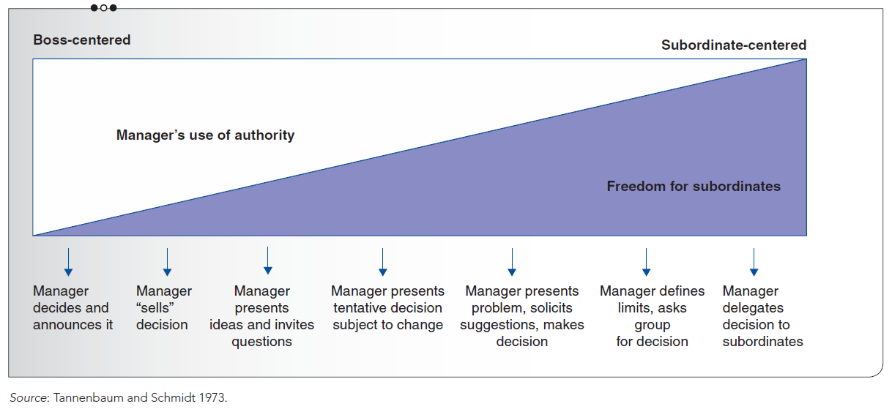
Tannenbaum and Schmidt’s Leadership Continuum

Slide 34
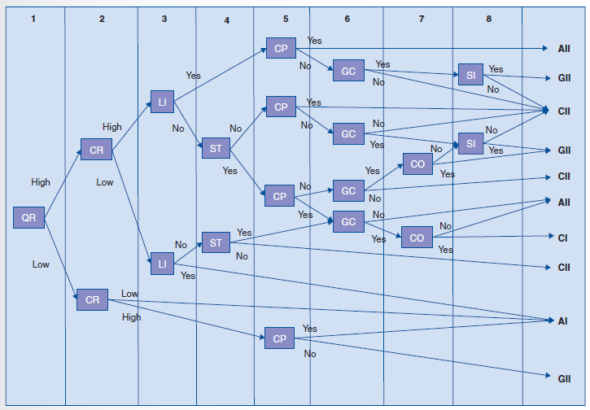
Normative Decision Tree
Quality requirement (QR)
Commitment requirement (CR)
Leader’s information (L I)
Problem structure (S T)
Commitment probability (CP)
Goal congruence (GC)
Subordinate conflict (CO)
Subordinate information (SI)

Slide 35
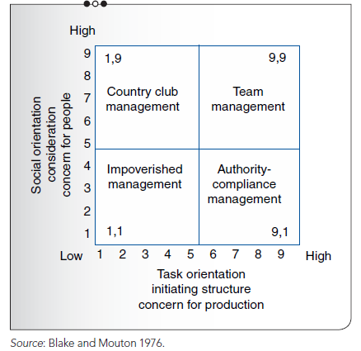
Leadership Matrix Models

Slide 36
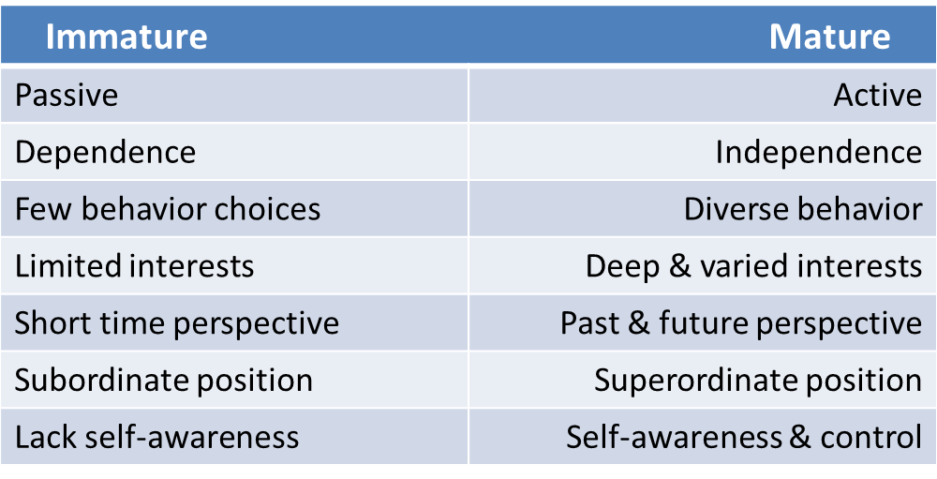
Worker Immaturity—Maturity Continuum

Slide 37
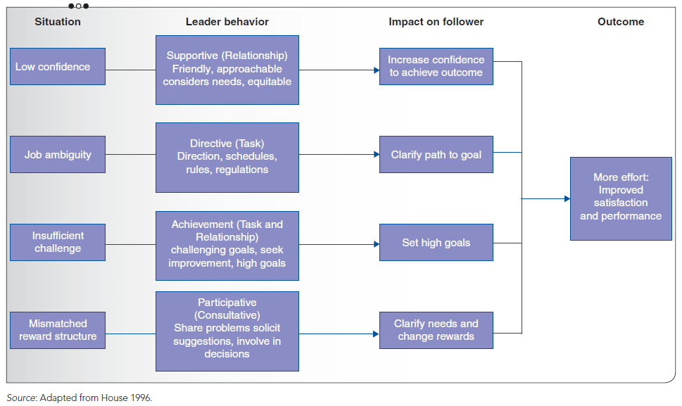
Path–Goal Theory

Slide 38
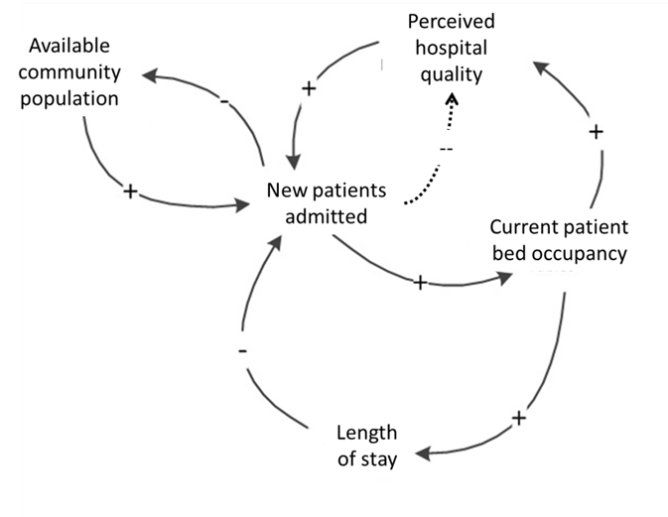
Causal Loop Systems View of Hospital Occupancy

Slide 39
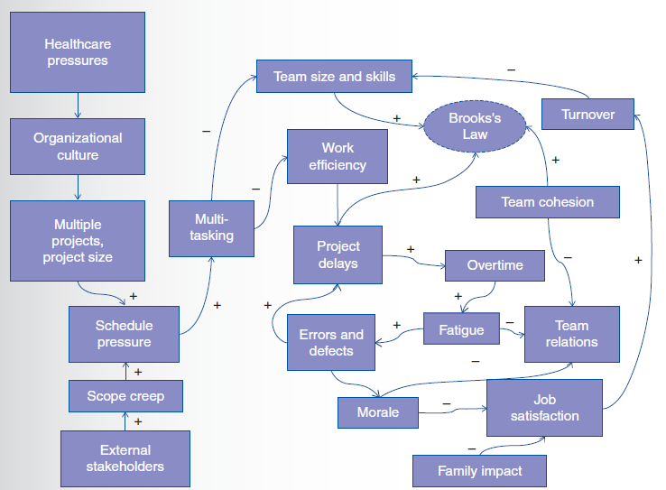
A Systems View Of Overtime Effects
Source: Swenson 2014

Slide 40
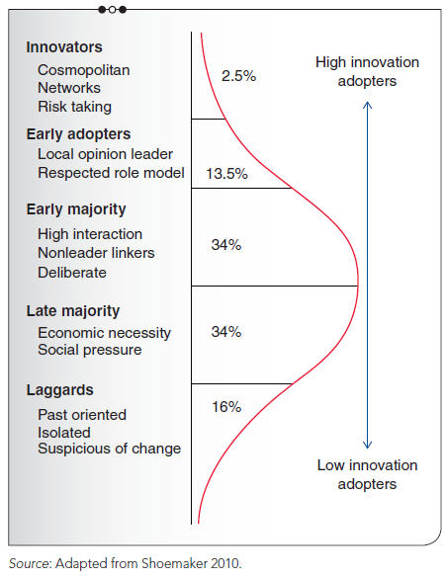
Characteristics of Innovation Stakeholders

Slide 41
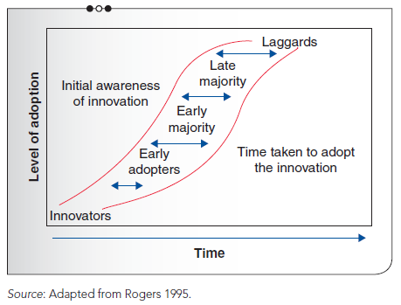
Innovation Diffusion S-curve

Slide 42
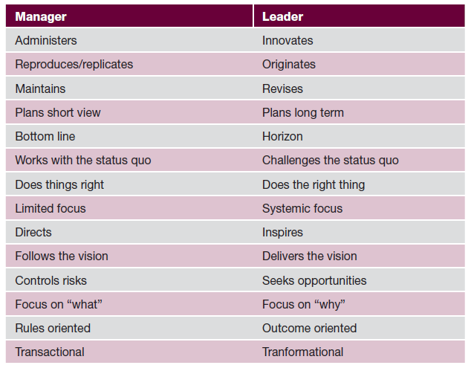
Differences between Managers and Leaders

Slide 43
Advantages and Disadvantages of Internal and External Change Agents
 | Internal Change Agent | External Change Agent
Advantages | 1. Knows the environment, culture, people, issues, and hidden agendas 2. Develops and keeps expertise and resources internal 3. Creates and maintains norms of organization renewal from within 4. Provides higher security and confidentiality 5. May have trust and respect of others 6. Has strong personal investment in success | 1. Provides fresh, outside, objective perspective 2. Is willing to assert, challenge, and question norms 3. May have more legitimacy to insiders by not taking sides 4. Brings skills and techniques not available from within organization 5. Brings diverse organizational experiences to bear; benchmarks comparisons

Slide 44
Advantages and Disadvantages of Internal and External Change Agents
Disadvantages | 1. May be biased; has already taken sides, or may be disliked or mistrusted by some stakeholders 2. May have previous relationships that contribute to subgrouping or fragmentation 3. Takes change agent away from other duties 4. May be enculturated and is “part of the problem” or does not see it 5. Is subject to organizational sanctions and pressures as an employee | 1. May or may not be available when needed by the organization; may split time and commitments with other clients 2. Incurs high expense 3. Takes time to become familiar with the system 4. May create codependency or may abandon the system

Slide 45
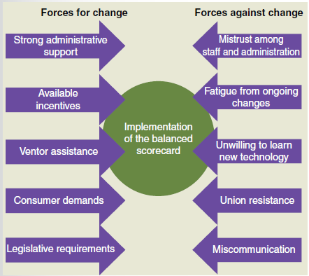
Force Field Analysis of Forces for the Balanced Scorecard

Slide 46
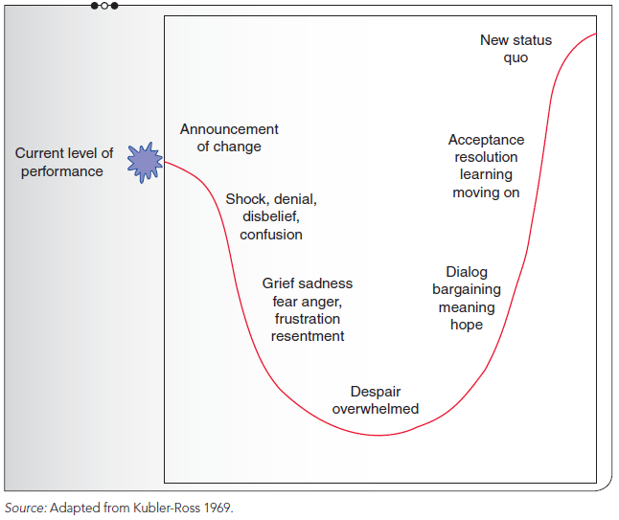
Adapted from Kubler-Ross’s Stages of Grief

Slide 47
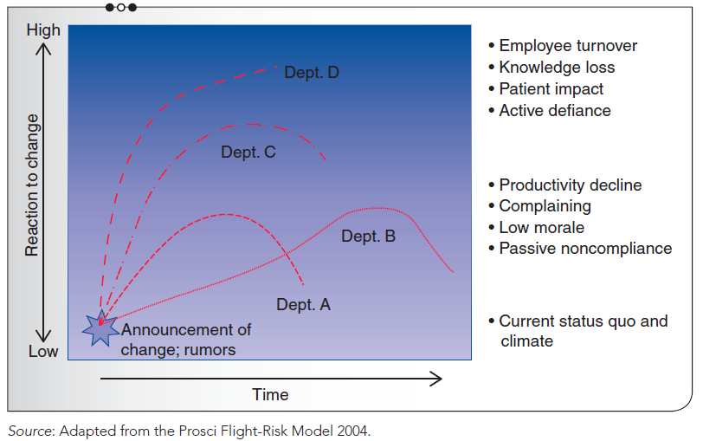
Variable Impact of Change on Different Stakeholders

