Slide 1
Quality and Performance Improvement in Healthcare: Theory, Practice, and Management
Seventh Edition
Chapter 2
Defining a Performance Improvement Model
© 2020 American Health Information Management Association

Slide 2
Learning Objectives
Model the cyclical nature of performance improvement activities
Define terminology and standards common to performance improvement activities
Distinguish between organization-wide performance improvement activities and team-based performance improvement activities
Apply the organization-wide performance improvement cycle
Use the team-based performance improvement cycle

Slide 3
Performance Improvement Terminology
Q A—Quality assurance
TQM—Total quality management
Q I—Quality improvement
C Q I—Continuous quality improvement
QM—Quality management
P I—Performance improvement

Slide 4
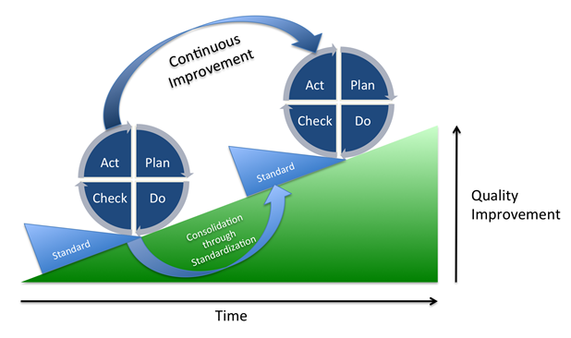
Deming’s P D C A Cycle
Source: Vietze, J. 2013 (June). “PDCA_Process.png.” Digital Image. Wikimedia Commons.
https://upload.wikimedia.org/wikipedia/commons/a/a8/PDCA_Process.png.
Jump to Deming’s P D C A Cycle, Appendix
Notes:
This PDCA cycle has been modified over the years to become the plan, do, study, act (PDSA) cycle where “check” has been replaced with “study.”

Slide 5
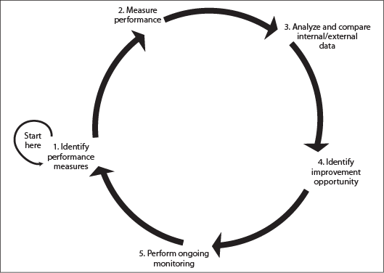
Performance Improvement as a Cyclical Process
Organization-wide performance improvement process
Jump to Performance Improvement as a Cyclical Process, Appendix

Slide 6
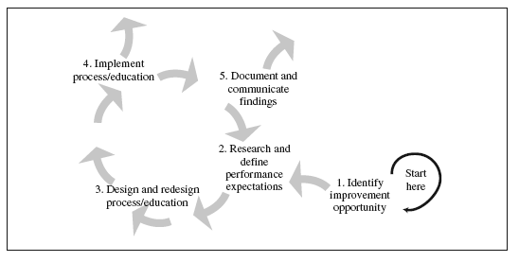
Team-Based Performance Improvement Process
Jump to Team-Based Performance Improvement Process, Appendix

Slide 7
Performance Improvement Model
Jump to Performance Improvement Model, Appendix

Slide 8
Monitoring Performance Through Data Collection
Performance measure: A quantitative tool that provides an indication of an organization’s performance in relation to a specified process or outcome
Rate
Ratio
Index
Percentage
Benchmarking: Comparing your organization’s performance to that of similar organizations

Slide 9
Performance Measure
Numerator (number of times it occurred) divided by denominator (number of times it could have occurred)

Slide 10
Performance Measure Example
Number of patient records with appropriate documentation divided by number of patient records reviewed

Slide 11
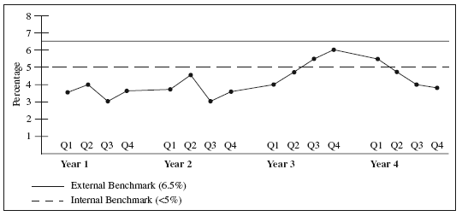
Benchmark Example
Community Hospital of the West employee turnover rate
Jump to Benchmark Example, Appendix

Slide 12
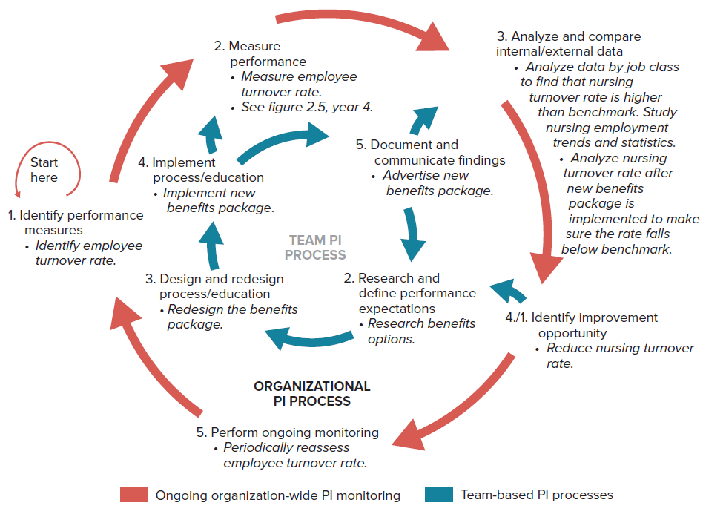
Community Hospital of the West Performance Improvement Model
Jump to Community Hospital of the West Performance Improvement Model, Appendix

Slide 13
Systems Thinking
Viewing an organization as an open system of interdependencies and connectedness rather than a collection of individual parts and professional enclaves
Sees interrelatedness as a whole and looks for patterns rather than snapshots of organizational activities and processes

Slide 14
Systems Analysis Tools, 1
Modeling and simulation
Queuing methods
Discrete-event simulation
Enterprise management
Supply-chain management
Game theory and contracts
Systems dynamic models
Productivity measuring and monitoring

Slide 15
Systems Analysis Tools, 2
Financial engineering and risk management
Return on investment
Reduce risk
Increase efficiency
Knowledge discovery
Data mining
Predictive modeling
Neural networks

Slide 16
Systems Control Tools
Statistical process control
Illustrates whether a process is stable or unstable
Scheduling
Ensuring the right resources are in place at the right time

Slide 17
Performance Improvement Frameworks
Six Sigma
Lean
Lean Six Sigma
High reliability organizations (H R Os)

Slide 18
Six Sigma
Uses statistics for measuring variation in a process with the intent of producing error-free results
Refers to the standard deviation used in descriptive statistics to determine how much an event or observation varies from the estimated average of the population sample
Measure indicates no more than 3.4 errors per million encounters

Slide 19
Lean, 1
Streamline processes in:
Overproduction
Wasting time
Waste of stock on hand
Waste of movement
Waste of defective
Waste in transportation
Waste in processing

Slide 20
Lean, 2
Adoption in healthcare
Attention to the customer (patient-centered care) and their perspective
Reduce unnecessary waste
Uses root-cause analysis

Slide 21
Lean Six Sigma
Combination of Lean and Six Sigma
Elimination of waste from Lean
Improving accuracy from Six Sigma
Creates processes that have both speed and accuracy

Slide 22
High Reliability Organizations
Learning to manage the unexpected
Mistakes and errors occur because of employees’ mindlessness and distraction
Mindlessness and distraction occur when employees are hurried or overloaded

Slide 23
Appendices

Slide 24
Deming’s P D C A Cycle, Appendix
The steps in the P D C A cycle are plan, do, check, and act. Continuous improvement in quality is achieved by repeating the cycle and consolidating the progress through standardization. There is a new standard every time the cycle is repeated. Over time, the overall quality of the process increases.
Jump back to Deming’s P D C A Cycle

Slide 25
Performance Improvement as a Cyclical Process, Appendix
The five steps in the cyclic process are as follows:
Step 1: Identify performance measures
Step 2: Measure performance
Step 3: Analyze and compare internal or external data
Step 4: Identify improvement opportunity
Step 5: Perform ongoing monitoring
Jump back to Performance Improvement as a Cyclical Process

Slide 26
Team-Based Performance Improvement Process, Appendix
The five steps in the process are as follows:
Step 1: Identify improvement opportunity
Step 2: Research and define performance expectations
Step 3: Design and redesign process or education
Step 4: Implement process or education
Step 5: Document and communicate findings
Steps 2 to 5 are cyclic in nature.
Also, steps 4 and 5 can lead to other possibilities.
Jump back to Team-Based Performance Improvement Process

Slide 27
Performance Improvement Model, Appendix
The five steps in the organizational performance improvement process that is cyclic are as follows:
Step 1: Identify performance measures
Step 2: Measure performance
Step 3: Analyze and compare internal or external data
Step 4: Identify improvement opportunity
Step 5: Perform ongoing monitoring
The five steps in the team-based performance improvement process are as follows:
Step 1: Identify improvement opportunity
Step 2: Research and define performance expectations
Step 3: Design and redesign process or education
Step 4: Implement process or education
Step 5: Document and communicate findings
Steps 2 to 5 in this process are cyclic in nature.
Step 4 in the organizational performance improvement process, identify improvement opportunity, is the first step in the team-based performance improvement process.
Step 4 in the team-based performance improvement process, implement process or education, leads to the second step, measure performance, in the organizational performance improvement process.
Step 5 in the team-based performance improvement process, document and communicate findings, leads to the third step, analyze and compare internal or external data, in the organizational performance improvement process.
Jump back to Performance Improvement Model

Slide 28
Benchmark Example, Appendix
The x-axis represents years—Year 1, Year 2, Year 3, and Year 4. Each year consists of the following quarters: Q 1, Q 2, Q 3, and Q 4. The y-axis represents the turnover rate in percentage. It ranges from 1 to 8.
The approximate data for Year 1 are as follows:
In Q 1, the employee turnover rate was 3.5 percent. In Q 2, the employee turnover rate was 4 percent. In Q 3, the employee turnover rate was 3 percent. In Q 4, the employee turnover rate was 3.5 percent.
The approximate data for Year 2 are as follows:
In Q 1, the employee turnover rate was 3.6 percent. In Q 2, the employee turnover rate was 4.8 percent. In Q 3, the employee turnover rate was 3 percent. In Q 4, the employee turnover rate was 3.5 percent.
The approximate data for Year 3 are as follows:
In Q 1, the employee turnover rate was 3.7 percent. In Q 2, the employee turnover rate was 4.8 percent. In Q 3, the employee turnover rate was 5.5 percent. In Q 4, the employee turnover rate was 6.1 percent.
The approximate data for Year 4 are as follows:
In Q 1, the employee turnover rate was 5.5 percent. In Q 2, the employee turnover rate was 4.8 percent. In Q 3, the employee turnover rate was 3.7 percent. In Q 4, the employee turnover rate was 3.6 percent.
The external benchmark is at 6.5 percent.
The internal benchmark is at a point less than 5 percent.
Jump back to Benchmark Example

Slide 29
Community Hospital of the West Performance Improvement Model, Appendix
The model has been applied to Community Hospital of the West. The five steps in the organizational performance improvement process that is cyclic are as follows:
Step 1: Identify performance measures, which involved identifying employee turnover rate.
Step 2: Measure performance, which involved measuring employee turnover rate. See figure 2.5, year 4.
Step 3: Analyze and compare internal or external data. This step involved three sub-steps. They are as follows:
Analyzing data by job class to find that nursing turnover rate is higher than benchmark.
Studying nursing employment trends and statistics.
Analyzing nursing turnover rate after implementing new benefits package to make sure the rate falls below benchmark.
Step 4: Identify improvement opportunity, which involved reducing nursing turnover rate.
Step 5: Perform ongoing monitoring, which involved periodical reassessment of employee turnover rate.
The five steps in the team-based performance improvement process are as follows:
Step 1: Identify improvement opportunity, which involved reducing nursing turnover rate.
Step 2: Research and define performance expectations, which involved researching benefits options.
Step 3: Design and redesign process or education, which involved redesigning the benefits package.
Step 4: Implement process or education, which involved implementing new benefits package.
Step 5: Document and communicate findings, which involved advertising new benefits package.
Steps 2 to 5 in this process are cyclic in nature.
Step 4 in the organizational performance improvement process, identify improvement opportunity, is the first step in the team-based performance improvement process.
Step 4 in the team-based performance improvement process, implement process or education, leads to the second step, measure performance, in the organizational performance improvement process.
Step 5 in the team-based performance improvement process, document and communicate findings, leads to the third step, analyze and compare internal or external data, in the organizational performance improvement process.
Jump back to Community Hospital of the West Performance Improvement Model

